Slide 1
Best Practices for Document Submission

Slide 2
Submission Requirements
The following documents must be sent to magnetapplications@ana.org after completing the online application:
Chief Nursing Officer's curriculum vitae or resume.
Current facility organizational chart showing the CNO’s and nursing's relationship to the entire facility.
Current nursing organizational chart. Include all areas where nursing is practiced.
List of the externally managed database(s) used for nurse satisfaction, patient satisfaction, and nurse-sensitive indicators.
Institutional review board (IRB) attestation letter.
Nurse Director/Assistant Vice President and Nurse Manager Eligibility & Reporting Table.
Notes:
The Nurse Manager and Nurse Leader educational requirement table is submitted as a supporting document at time of application.
Applications will be processed only if the educational requirement is met

Slide 3
CNO Curriculum Vitae
At the time of application the Chief Nursing Officer must have:
A degree in nursing-BSN or higher
A masters degree in any field

Slide 4
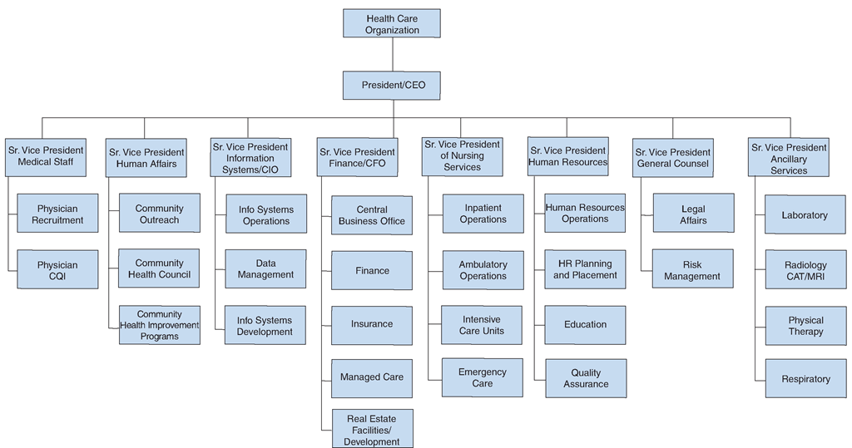
Facility Organizational Chart
Notes:
Current facility org chart showing the CNO and nursing’s relationship with the entire facility

Slide 5
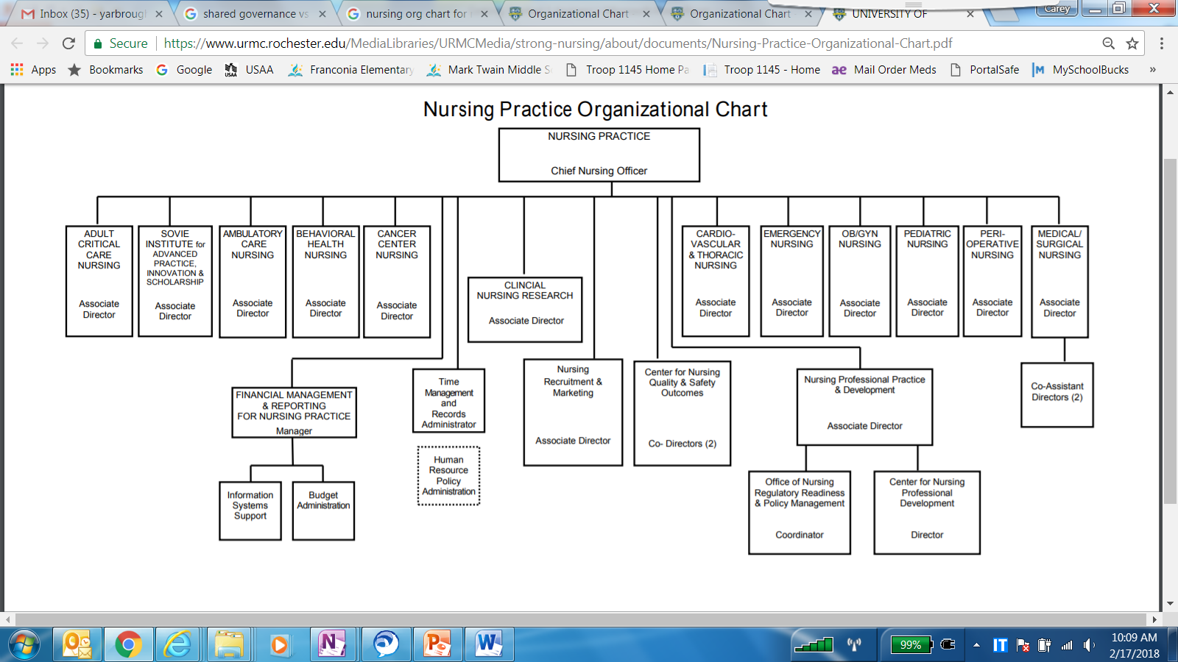
Nursing Organizational Chart
Notes:
Current nursing organizational chart including all areas where nursing is practiced, explain dot line

Slide 6
External databases and IRB
List of the externally managed database(s) used for nurse satisfaction, patient satisfaction, and nurse-sensitive indicators.
An organization’s IRB may be internal, external, or centralized at the system level
Requires that at least one nurse be a voting member of the governing body responsible for the protection of human research participants.

Slide 7
Nurse Director/Assistant Vice President and Nurse Manager Eligibility & Reporting Table

