Slide 1
Application & Document Appraisal Manager™ (ADAM™) Organization User Training
© 2018 American Nurses Credentialing Center. All rights reserved. This tool is designed to support the organization’s use of ADAM/ADAMplus. Any form of reproduction, dissemination, copying, disclosure, modification, distribution, or publication of this material is strictly prohibited.

Slide 2
What is ADAM?
ADAM is a secure on-line application that supports the creation, management, and internal review of narrative and supporting evidence.
ADAM allows Organization Users to:
Access the system from the time the document submission date is confirmed through completion of the appraisal process.
Compile content for one or more drafts for each SOE/Example.
Upload documents to the Document Library or directly to an SOE/Example.
Associate Document Library items with one or more SOE/Examples.
Flag content for internal review prior to document submission.

Slide 3
Organization User Types
Organization Administrator
Maintains the organization’s accounts
Creates/edits narrative and evidence
Submits narrative and evidence to the Magnet Program office
Organization Contributor
Creates/edits narrative and evidence
Organizational Pre-Submission Reviewer
Views (cannot edit) all narrative and evidence
Typically leadership selecting the final drafts for each SOE/example for submission to the Magnet Program office
Organizational Post-Submission Reviewer
Views (cannot edit) narrative and evidence submitted to the Magnet Program office

Slide 4
Application Types
Both Simple Upload (ADAM) and Template Users (ADAMplus)
Applicant uploads evidence in PDF format.
Content is searchable.
SOE/examples are flagged for PHI, additional documentation, & new content.
The system controls the number of evidence items submitted.
The system limits the users to 5 or less pieces of evidence.
For Nursing Satisfaction, Nursing Sensitive Indicators and Patient Satisfaction, the system allows one file (a single PDF of all graphs) to be uploaded.
The system verifies a complete submission.
Simple Upload User (ADAM)
Applicant uploads narratives in PDF format.
Template User (ADAMplus)
Applicant completes a template for entering narrative content which guides the inclusion of all key elements.

Slide 5
Account Maintenance
Notes:
Select the ADMIN tab then slide the cursor down to the Account link to access this screen.
Information about the organization user
Name
Role
Organization
Logout link
Links to edit user information
Button to add a new user account

Slide 6
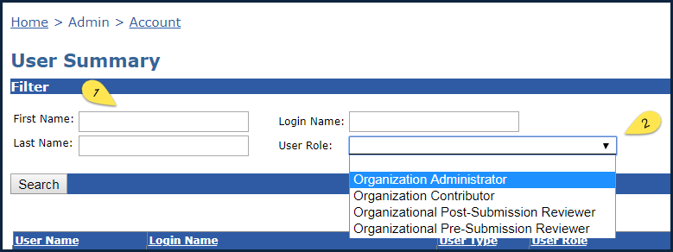
Account Filters
Notes:
Three search filters, First Name, Last Name, and Login Name are free text items.
The User Role filter is a drop down of organization user types.

Slide 7
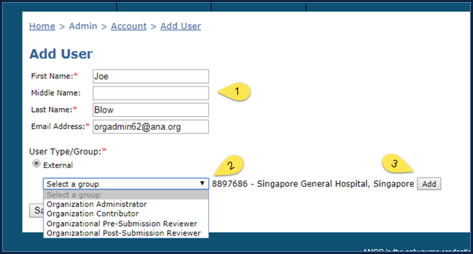
Add a New User
Notes:
Enter the name.
Assign the role.
Select the “Add” button.

Slide 8
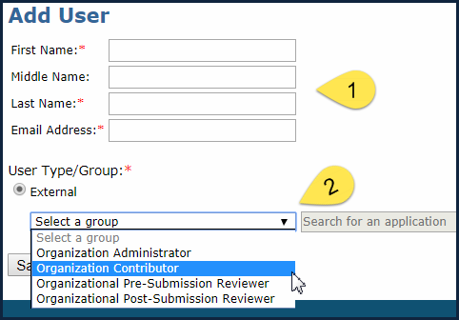
Close Up of Select User Role

Slide 9
New User Added
Notes:
1. A new user has been added. Note the “Save” and “Cancel” buttons.

Slide 10
Remove a User from One or More Organizations
Notes:
To remove a user from a single organization, uncheck the box to the left of the organization name, then select Save.
To remove a user from all organizations, select the Delete button.

Slide 11
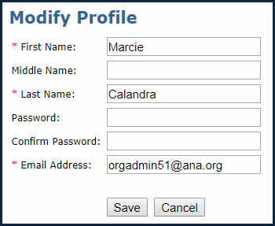
Individual User Profile Modification
Notes:
When the user selects the “Profile” link in the upper right corner of the screen, the user can edit the fields shown in the Modify Profile screen shot.
a. First Name
b. Middle Name
c. Last Name
d. Password
e. Confirm Password
f. Email Address

Slide 12
Choose Your Product
Select Your Product
ADAM
(Simple Upload User)
ADAMplus
(Template User)
Notes:
For information about the Simple Upload User experience, select that button.
For information about the Template User experience, select that button.

Slide 13
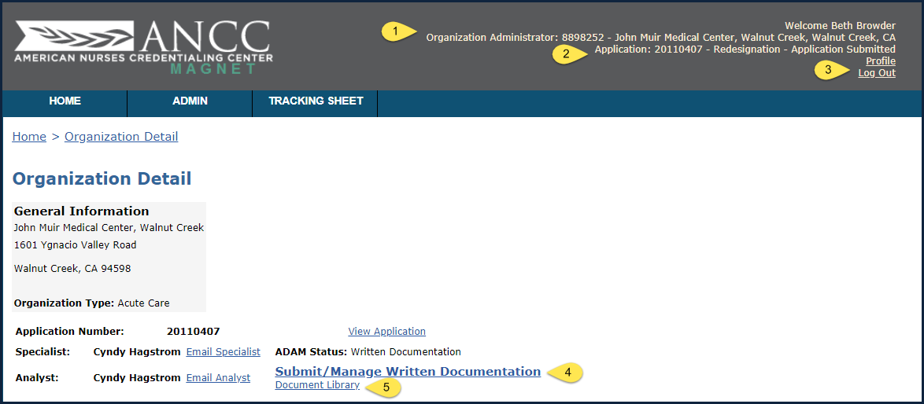
Organization Detail
Notes:
1, The name of the user who is logged into the system is displayed in the upper right corner of the screen.
2. The application number (year and month the application was submitted appended by the place order of the application during that month (e. g. the 11th application received in the Magnet Program office during August of 2011).
3. Access to the user Profile and Log Out links.
4. A link to manage your written documentation.
5. A link to manage your document library.

Slide 14
Basic ADAM Document Review Cycle
Applicant Writes & Submits Documents
Appraiser Team Reviews Submitted Documents
Magnet Analyst Processes Review

Slide 15
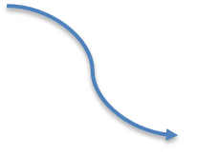
Written Documentation Phase
Status | Actions
Written Documentation (prior to submission) | Applicant can edit. Appraiser and Analyst have no access.
Written Documentation Review (by Appraisers and Analysts) | Appraiser can read, add notes, and flag SOEs. Analyst releases selected SOEs.
Organization submits document
Organization submits document
Appraisers review document
Appraisers review document
Analyst releases selected SOEs
Analyst releases selected SOEs

Slide 16
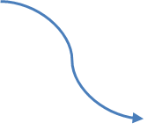
Additional Documentation Phase
Status | Actions
Revise/Additional Written Documentation Review (by Appraiser and Analysts) | Appraiser can read, add notes, and flag SOES. Analyst releases selected SOEs.
Revise/Additional Written Documentation (Applicant is revising content) | Applicant can edit unlocked SOEs. Appraiser and Analyst can view locked SOEs.
Organization submits document
Organization submits document
Appraisers review document
Analyst releases selected SOEs

Slide 17
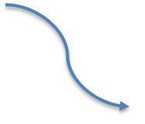
Deficiencies Going to Site Visit Phase
Status | Actions
Pre-Site Visit Additional Documentation Requested (Applicant is revising content) | Applicant can edit unlocked SOEs. Appraiser and Analyst can view locked SOEs.
Pre-Site Visit Additional Documentation Review (by Appraiser and Analysts) | Appraiser can read, add notes, and flag SOEs. Analyst releases selected SOEs.
Organization submits document
Organization submits document
Appraisers review doucment
Appraisers review doucment
Analyst releases selected SOEs

Slide 18
PHI
Status | Actions
PHI (confirmed by Analyst) | Appraiser has no access. Analyst can unlock additional SOEs. Applicant can view all SOEs and edit unlocked SOEs.
Analyst unlocks SOEs with PHI
Analyst notifies Applicant
Applicant edits unlocked SOEs

Slide 19
Completion
Status | Actions
Complete (appraisal fully completed) | Appraiser and Analyst can view. Applicant has no access.

Slide 20
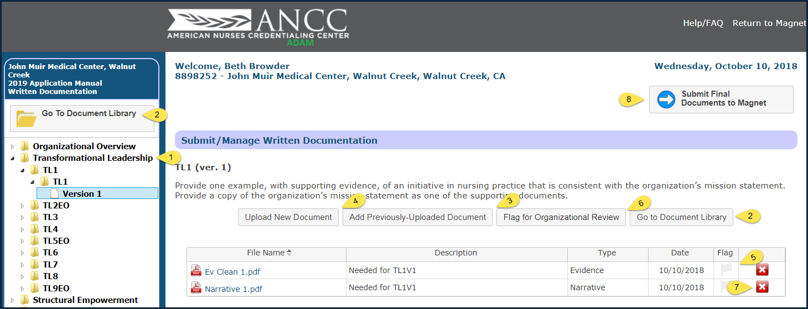
Simple Upload User
Submit/Manage Written Documentation
Notes:
The left navigation allows you to navigate down from the component, through the source of evidence (SOE), through the SOE/Example (if applicable for the SOE), to the version of the SOE/Example you decide to upload information to.
The “Go to Document Library” button takes you to the library where you can upload documents prior to associating them with specific SOE/Examples.
The “Add Previously Uploaded Document” allows you to associate a document that is already in the document library with the SOE/Example you are working with.
The “Upload New Document” button enables you to upload a document specific to this SOE/Example.
Select the greyed out flag symbol to identify a document to be included for organizational (perhaps the Chief Nursing Officer) review.
The “Flag for Organization Review” button places a green flag indicator on the version in the left navigation to draw attention to the content.
Select the red button with the white “X” on it to delete a document from the SOE/Example.

Slide 21
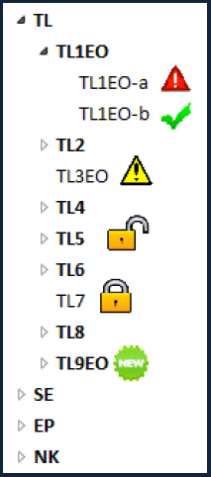
Left Navigation Icons
Red warning triangle: Appraiser/Analyst only
Red stop sign: Location of PHI
Green checkmark: SOE/example is complete
Yellow warning triangle: Appraiser/Analyst only
Open lock icon: SOE/example has been unlocked; user may edit/provide additional information
Closed Lock icon: SOE/example is locked
Green "New" icon: indicates to Appraisers and Analysts that applicant has submitted revised information.

Slide 22
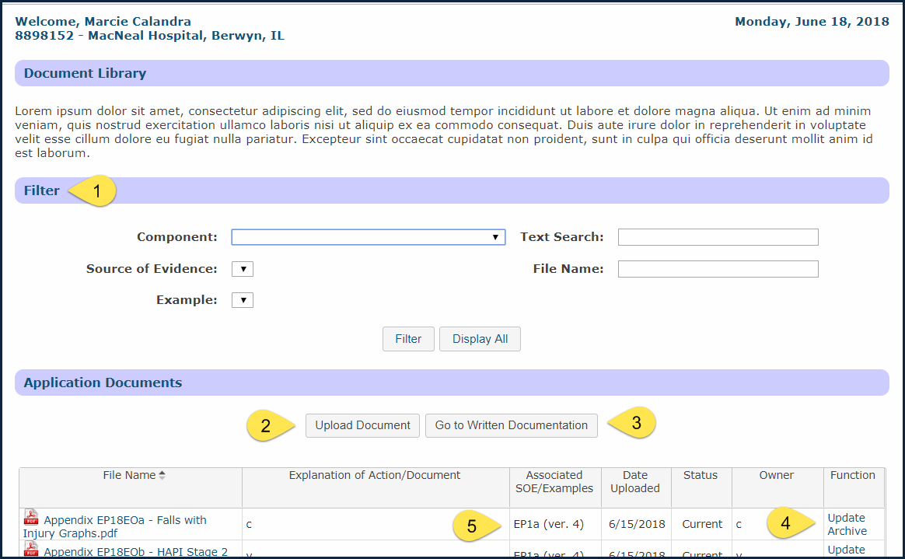
Document Library
Notes:
1. The filters allow you to search for documents that have already been uploaded to the library.
2. The “Upload Document” allows you to add a document to the library.
3. The “Go to Written Documentation” button lets you navigate to a specific SOE/Example.
4. Function: See next slide.
5. Associated SOE/Examples shows you where the document is currently being used.

Slide 23
Function Fields
Update: The function uploads a new/updated document to replace the existing document. When a document is updated, links to SOEs/examples remain active.
Archive: When an applicant determines that a document is not needed for the current use, but may be needed later in the process, this is when they want to archive the document.
Retrieve: When an applicant determines that they want access to an archived document, they are able to “retrieve” it. Retrieving a document makes it available to the team for use in the current process.

Slide 24
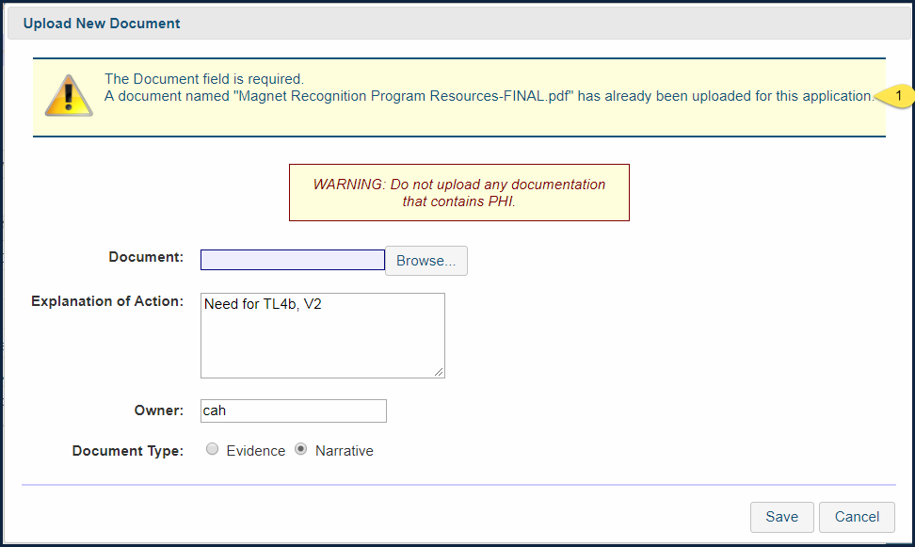
Duplicate Document Upload Error
Notes:
If the document you attempt to upload to the Document Library has the same file name as a document that has already been uploaded there, you will see this message.
Return to the Document Library and use the filters to locate the file to determine whether the file your are trying to upload already exists or whether you need to change the name of the file you need to upload.

Slide 25
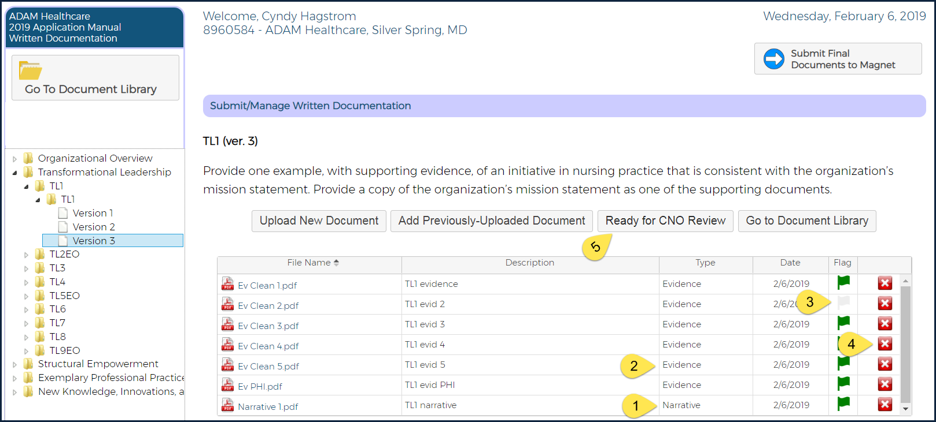
Simple Upload User
Submit/Manage Written Documentation
Clicking the “Ready for CNO Review" button marks the Source of Evidence/Example as completed.
ADAM then validates that the user has flagged for submission only one Narrative and only up to 5 Evidence documents.
Notes:
Narrative document indicator.
Evidence document indicator.
Select the greyed-out Flag icon to flag documents for inclusion in the SOE/Example.
Note: Most OOs and SOE/Examples allow you to upload up to five evidence documents. Some restrict the number of pieces of evidence to a single file when a single file is all that is called for.
Select the red button with the white “X” on it to delete a document’s association with the SOE/Example.
Select the “Ready for CNO Review” button when you have selected the best narrative and the best evidence for supporting the narrative.
This indicates that the content is ready for the CNO to review.
If the CNO approves the content, this flag indicates that this content should be included as part of the documentation submitted to Magnet.

Slide 26
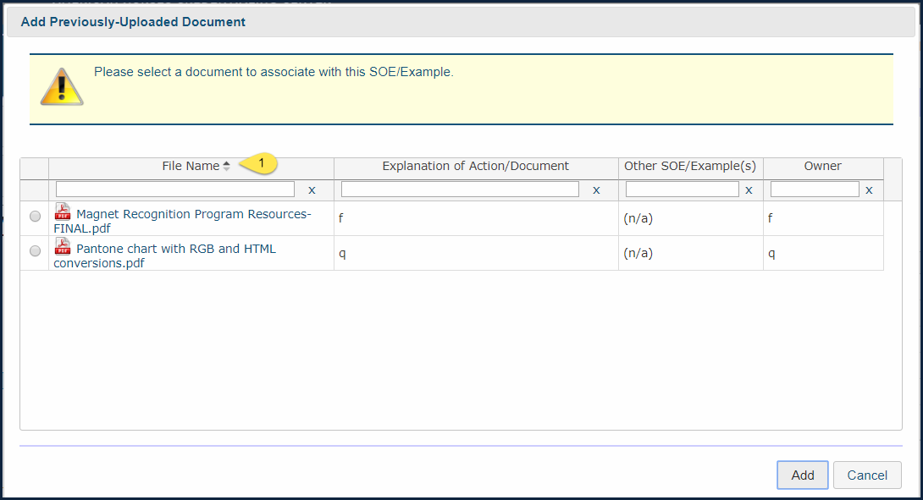
Add Previously Uploaded Document
Notes:
Use the four filters to search for the needed document.

Slide 27
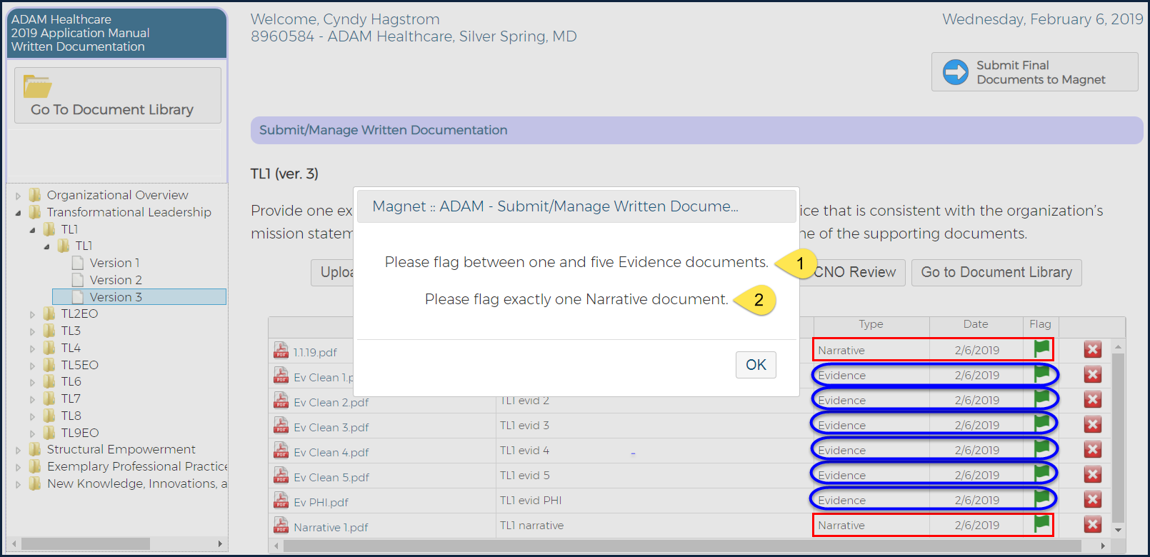
Simple Upload User
Document Flagging Error
Notes:
After you associate all of the documents that are needed for the SOE/Example you are working on, you will flag the individual files you want to include in your document submission for this SOE/Example. Note the green flag symbols to the immediate left of the red delete buttons.
Once that has been done, you can select the “Ready for CNO Review” button. This causes a green check mark to be placed on the SOE/Example label in the left navigation. The flag indicates that work has been completed on this SOE/Example and that it is ready to be reviewed by the Organizational Pre-Submission Reviewer (typically the CNO).
Selecting the “Ready for CNOReview” button causes the system to verify that a single narrative document and fewer than six evidence documents have been flagged for the SOE/Example.
If more than one narrative document or more than five evidence documents have been flagged, a message will popup stating what needs to be changed.

Slide 28
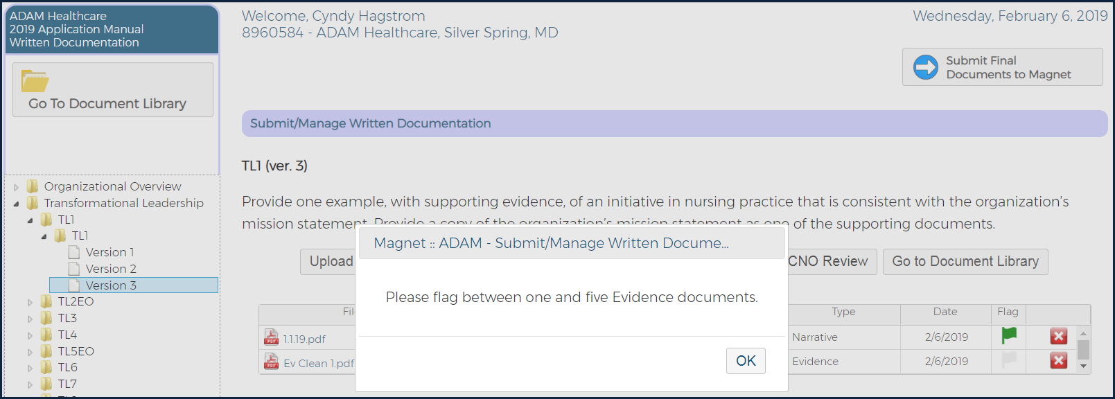
Validation of Submission Requirements
When you “Ready for CNO Review”, ADAM conducts validation to ensure that at one narrative and at least one evidence file have been flagged.
An error message displays if a requirement is not met.

Slide 29
Organizational Overview and SOE/Examples Needing only Narrative or Evidence
No Narrative Required:
OO2 OO4 OO5 OO7
OO8 OO9 OO10
No Evidence Required:
OO1 OO6 SE9a EP18EO
EP19EO EP20EO EP21EO NK1

Slide 30
Organizational Overview and SOE/Examples Special Cases
Some OOs/SOE/Examples require only a narrative or only evidence.
Create a file named “Narrative Replacement” and another file named “Evidence Replacement”.
Upload these two files to the Document Library.
Upload one of these two files as indicated for each of the Organizational Overview and SOE/Examples listed above.
For OOs that ask for evidence such as “quality plan(s)” or policies regarding “rights”, combine individual documents into piece of evidence meet system limits on the number of pieces of evidence.
Provide copies of the most recent quality plans
Graphs for EOs must be submitted as evidence.

Slide 31
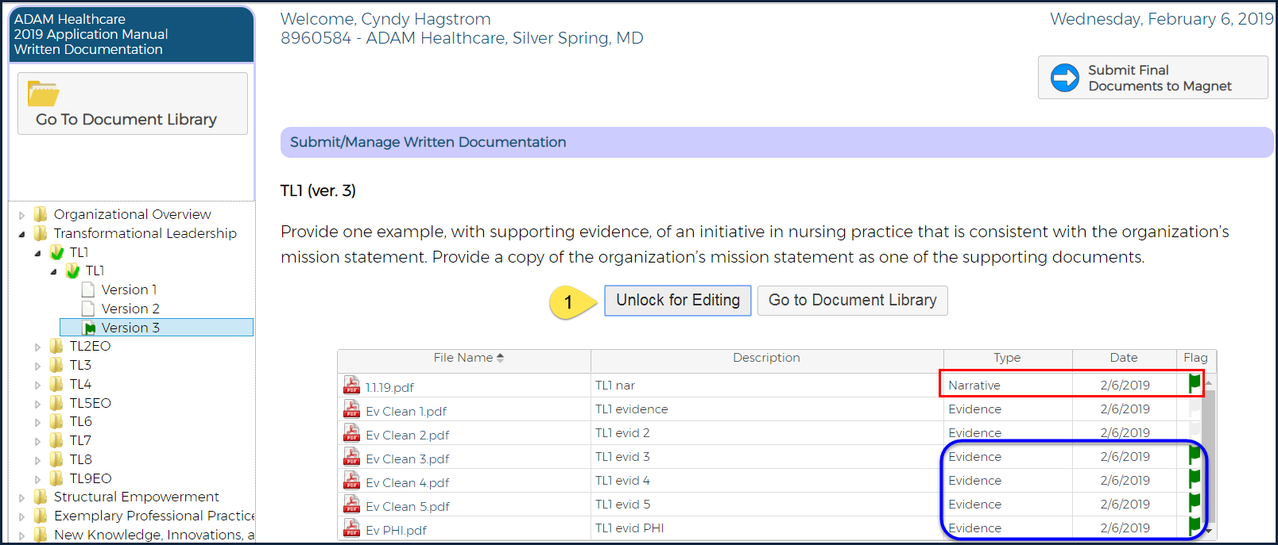
Simple Upload User - SOE/example Flagged for Organizational Review
Notes:
The organization user can select the “Unlock for Editing” button to resume work on the item.
The green flag in the left navigation indicates the item that is Ready for CNO Review.
The green check mark on the SOE/example label in the left navigation indicates that the SOE/Example is ready for review.

Slide 32
Submit Final Document to Magnet
Notes:
1. When all of the SOE/Examples needed to complete a document for submission to the Magnet Program office for review, select the “Submit Final Documents to Magnet” button.
2. If the correct number of Organizational Overview and SOE/Examples have been submitted, you will see the Submit message shown.

Slide 33
Validation of Final Document Submission Requirements
If an applicant submits fewer than the required number of examples for a source of evidence, the system displays a confirmation dialogue box when the organization administrator clicks “Submit Final Documents to Magnet” button. The confirmation dialogue box reads “You have submitted fewer than the required number of examples for (insert SOE code). Are you sure your documentation is complete?“

Slide 34
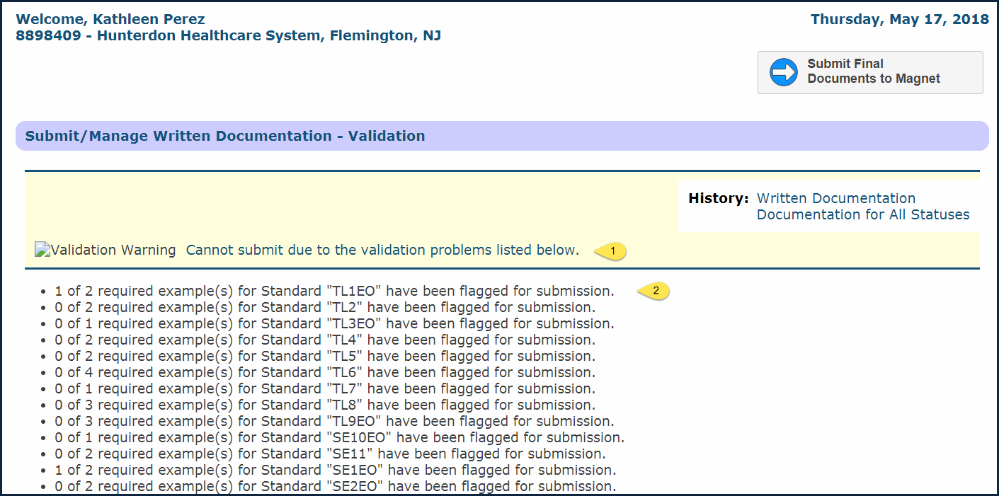
Submit Final Document Validation Error Message
FIRST navigate to the first folder noted as having an issue.
Note: Do not remove documents from the Document Library until you have selected the Unlock for Editing button for this SOE/example.
Notes:
This is the general validation error message.
If there is an error for an Organizational Overview item or an SOE/Example, it appears as a unique line item

Slide 35
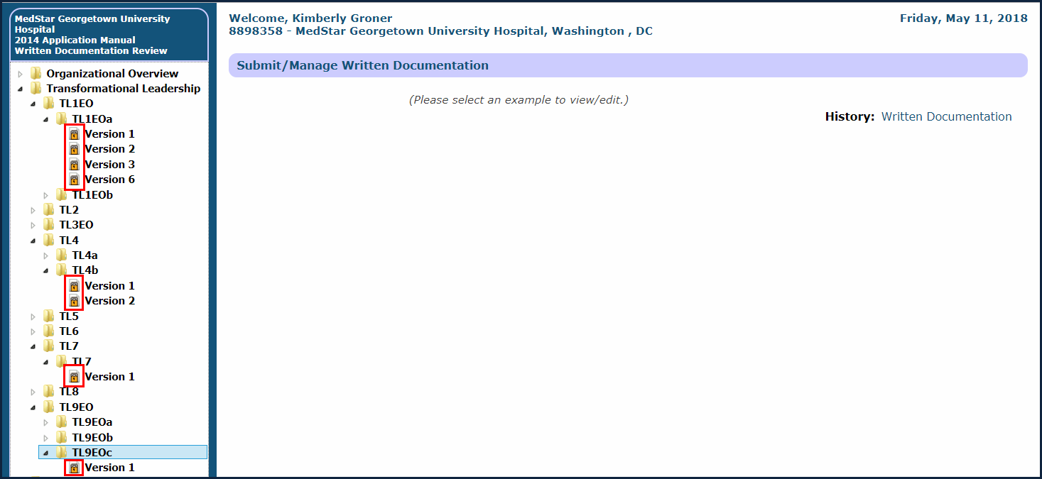
Lock Icons after Submitting Documents
Notes:
The locked padlocks in the left navigation indicate that the organization user cannot edit the content for the Organizational Overview or SOE/Example item after their documents have been submitted to the Magnet Program office for review.

Slide 36
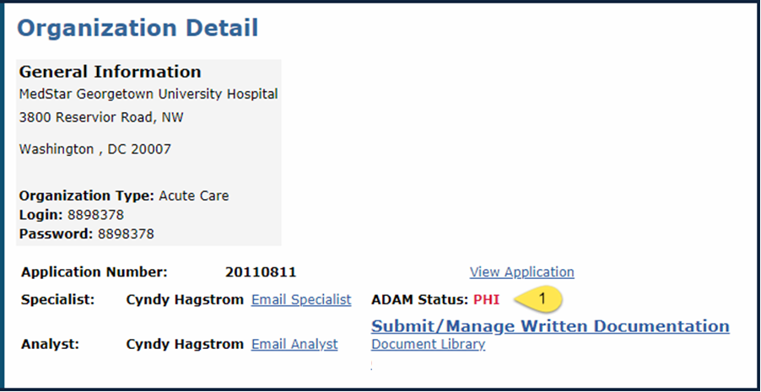
Organizational Detail Screen with PHI Identified
Notes:
When an application is placed in PHI status, the Organization Administrator is notified of the specific Organization Overview or SOE/Examples where the PHI was identified. They receive information about when the PHI must be resolved. The organization is responsible to review all other areas of the document for PHI and remove it. If PHI is found again, the application review will cease.

Slide 37
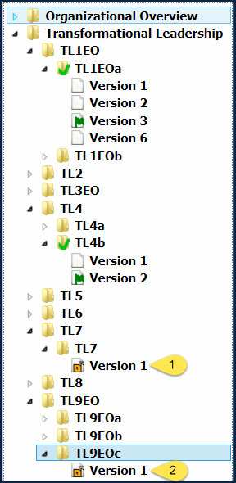
PHI/Additional Documentation Request Locations Unlocked for Resolution

Slide 38
Simple Upload User
Delete Document Containing PHI
Notes:
1. The unlocked padlock in the left navigation indicates the item where PHI was identified.
Note: The Organization Administrator will be notified via email in which document(s) PHI was found.
3. An Organization Administrator or Contributor can remove the document containing PHI by selecting the red delete button to the right of the document’s information.

Slide 39
PHI Not Addressed by Due Date
If the Organization does not delete PHI before the date set by the Magnet Senior Program Analyst:
All content submitted for the example(s) identified as having PHI will be automatically deleted from the system.
The History links for the example(s) identified as having PHI will lead to a blank screen.

Slide 40
Navigation to History Link Content
In the left navigation select the Component, then the SOE, then the Example, then the version of the Example to reach the Submitted Example.
The history content for each status will open in the browser on a new tab.

Slide 41
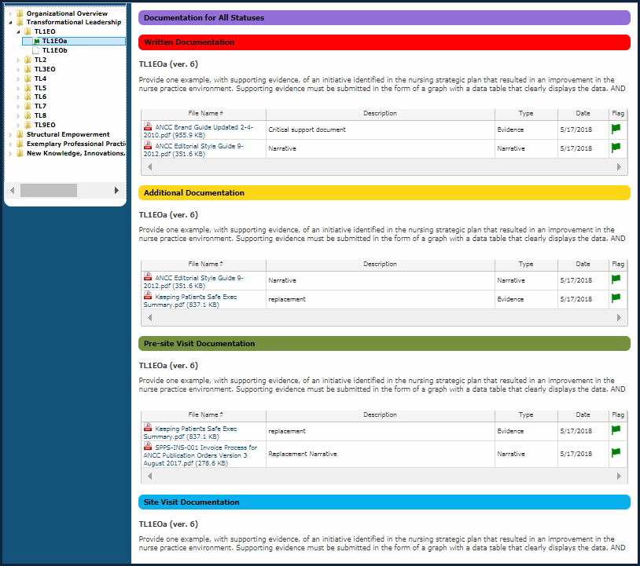
Simple Upload User
History of Statuses for an SOE/Example

Slide 42
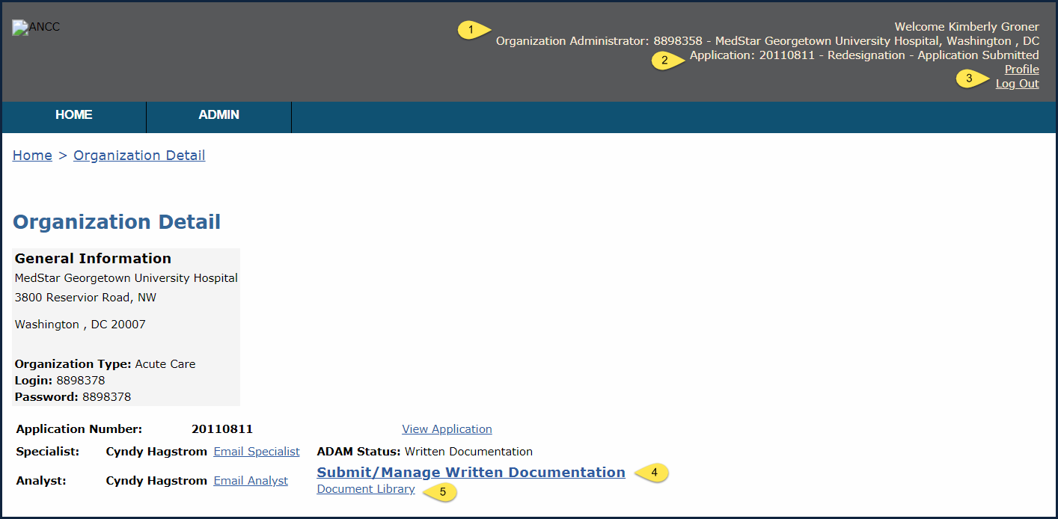
Organization Detail
Notes:
1, The name of the user who is logged into the system is displayed in the upper right corner of the screen.
2. The application number (year and month the application was submitted appended by the place order of the application during that month (e. g. the 11th application received in the Magnet Program office during August of 2011).
3. Access to the user Profile and Log Out links.
4. A link to manage your written documentation.
5. A link to manage your document library.

Slide 43
Written Documentation Phase
Status | Actions
Written Documentation (prior to submission) | Applicant can edit. Appraiser and Analyst have no access.
Written Documentation Review (by Appraisers and Analysts) | Appraiser can read, add notes, and flag SOEs. Analyst releases selected SOEs.
Organization submits document
Organization submits document
Appraisers review document
Appraisers review document
Analyst releases selected SOEs
Analyst releases selected SOEs

Slide 44
Additional Documentation Phase
Revise/Additional Written Documentation (Applicant is revising content) | Applicant can edit unlocked SOEs. Appraiser and Analyst can view locked SOEs.
Revise/Additional Written Documentation Review (by Appraiser and Analysts) | Appraiser can read, add notes, and flag SOES. Analyst releases selected SOEs.
Revise/Additional Written Documentation (Applicant is revising content) | Applicant can edit unlocked SOEs. Appraiser and Analyst can view locked SOEs.
Organization submits document
Organization submits document
Appraisers review document
Analyst releases selected SOEs

Slide 45
Deficiencies Going to Site Visit Phase
Status | Actions
Pre-Site Visit Additional Documentation Requested (Applicant is revising content) | Applicant can edit unlocked SOEs. Appraiser and Analyst can view locked SOEs.
Pre-Site Visit Additional Documentation Review (by Appraiser and Analysts) | Appraiser can read, add notes, and flag SOEs. Analyst releases selected SOEs.
Organization submits document
Organization submits document
Appraisers review doucment
Appraisers review doucment
Analyst releases selected SOEs

Slide 46
PHI Phase
Status | Actions
PHI (confirmed by Analyst) | Appraiser has no access. Analyst can unlock additional SOEs. Applicant can view all SOEs and edit unlocked SOEs.
Analyst unlocks SOEs with PHI
Analyst notifies Applicant
Applicant edits unlocked SOEs

Slide 47
Completion Phase
Status | Actions
Complete (appraisal fully completed) | Appraiser and Analyst can view. Applicant has no access.

Slide 48
Document Library
Notes:
1. The filters allow you to search for documents that have already been uploaded to the library.
2. The “Upload Document” allows you to add a document to the library.
3. The “Go to Written Documentation” button lets you navigate to a specific SOE/Example.
4. Function: See next slide.
5. Associated SOE/Examples shows you where the document is currently being used.

Slide 49
Function Fields
Update: The function uploads a new document to replace the existing document. When a document is updated, links to SOEs/examples remain active.
Archive: When an applicant determines that a document is not needed for the current use but may be needed later in the process when they want to archive the document.
Retrieve: When an applicant determines that they want access to an archived document, they are able to “retrieve” it. Retrieving a document makes it available to the team for use in the current process.

Slide 50
Document Upload Duplication Error

Slide 51
Add Previously Uploaded Document
Notes:
1. Use the four filters at the top of each column to search for the needed document. The up/down filter button appear when you select a column heading.

Slide 52
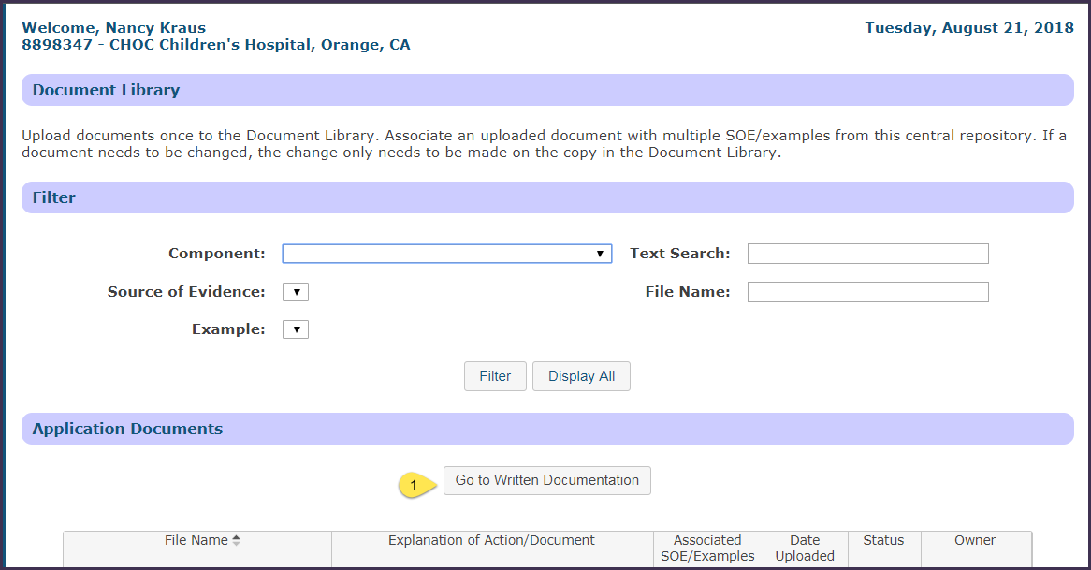
Navigate from Document Library to Submit/Manage Written Documentation
Notes:
1. Select the “Go to Written Documentation” button to navigate from the Document Library to the Submit/Manage Written Documentation screen.

Slide 53
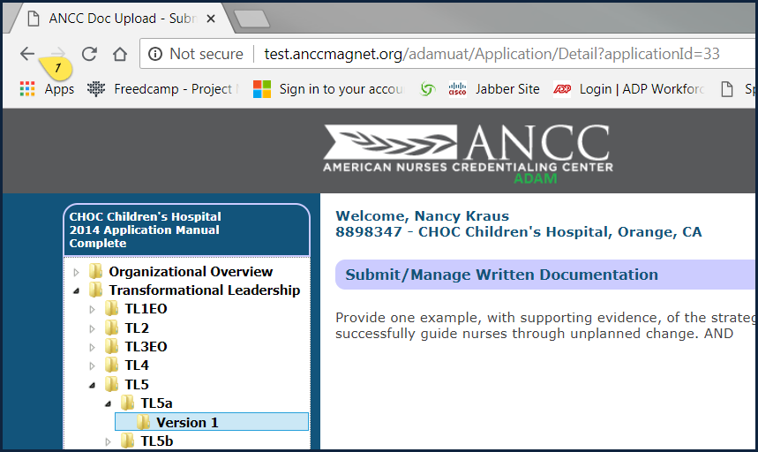
Navigate from Submit/Manage Written Documentation to Document Library
The Back Arrow comes into play here!
Notes:
1. Use the Back Arrow to navigate from the Submit/Manage Written Documentation screen to the Document Library.

Slide 54
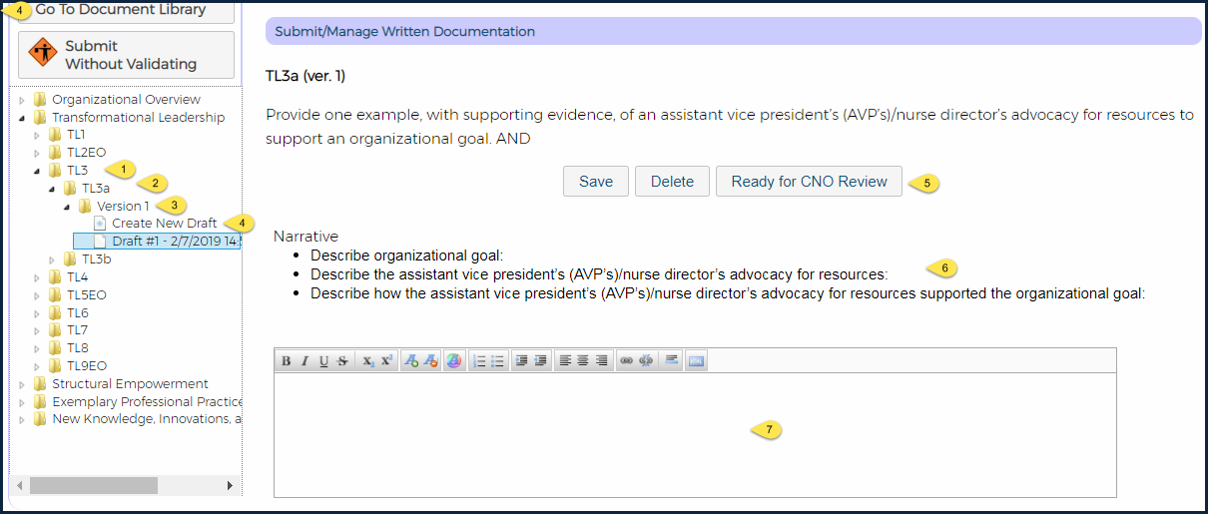
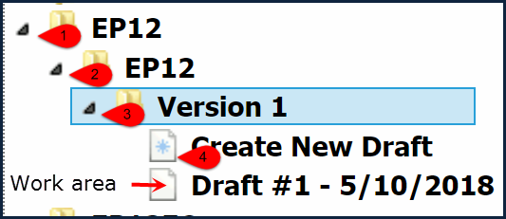
Template User
Submit/Manage Written Documentation
Notes:
1. Click the triangles to the left of left navigation items 1-3 to navigate to the Component and through the SOE, Example, and version to create a new draft.
Note: You may see more than one version for an SOE/Example if the Magnet Program office has revised the wording of the SOE/Example. You will be able to write to any version that was published after you were given access to the system.
4. You must select the draft you created to work in the template.
5. Select the “Flag for Organizational Review” when you have completed the template, uploaded and flagged evidence items., and selected the Save button.
6. Each part of the template describes what needs to be included and may provide notes and tips.
7. Various types of data entry areas may be used in template.

Slide 55
Template User
Flag Documents for Inclusion in Evidence
If the number of evidence items does not meet the limit set for and OO or an SOE/Example, the user will receive an error message.
Notes:
The general error message notifies the user that there is an issue.
The green flag icon indicates which documents were included in the attempt to Flag for Organizational Review.
The red “X” icon allow the user to remove an unneeded document.

Slide 56
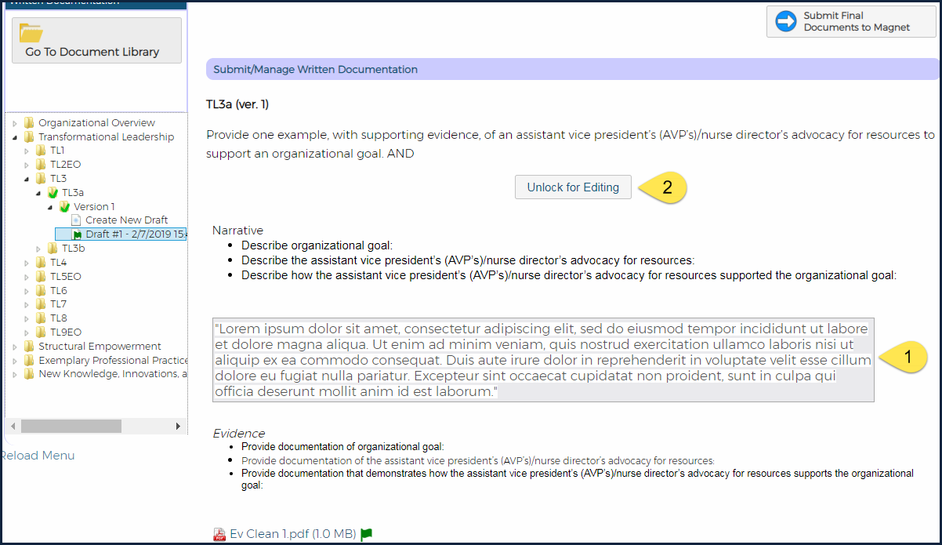
Template User
Completed SOE/Example Flagged for Review
The “Unflag for Organizational Review” button allows the organization to edit the example further.
Notes:
Complete all elements of the template.
The label on this button changes to indicate whether the document is flagged for review or open for editing.

Slide 57
Left Navigation Icons
Red warning triangle: Appraiser/Analyst only
Red stop sign: Location of PHI
Green checkmark: SOE/example is complete
Yellow warning triangle: Appraiser/Analyst only
Open lock icon: SOE/example has been unlocked; user may edit/provide additional information
Closed Lock icon: SOE/example is locked
Green "New" icon: indicates to Appraisers and Analysts that applicant has submitted revised information.

Slide 58
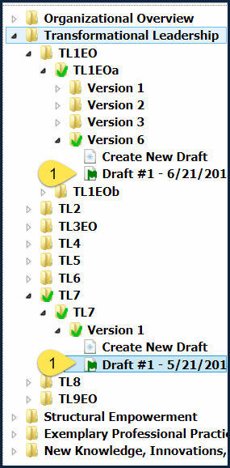
Flag for Organization Review
Notes:
1. The green flag on the draft indicates that it is flagged for Organizational Review. The green check marks on the other navigation levels lead the user to the flagged draft.

Slide 59
Submit Final Documents to Magnet
Notes:
1. When all of the SOE/Examples needed to complete a document for submission to the Magnet Program office for review, select the “Submit Final Documents to Magnet” button.
2. If the correct number of Organizational Overview and SOE/Examples have been submitted, you will see the Submit message shown.

Slide 60
Validation of Submission Requirements
If an applicant submits fewer than the required number of examples for a source of evidence, the system displays a confirmation dialogue box when the organization administrator clicks “Submit Final Documents to Magnet” button. The confirmation dialogue box reads “You have submitted fewer than the required number of examples for (insert SOE code). Are you sure your documentation is complete?“

Slide 61
Document Validation Error Message
FIRST navigate to the first folder noted as having an issue.
Note: Do not remove documents from the Document Library until you have selected the Unlock for Editing button for this SOE/example.
Notes:
This is the general validation error message.
If there is an error for an Organizational Overview item or an SOE/Example, it appears as a unique line item

Slide 62
Lock Icons after Submitting Documents
Notes:
The locked padlocks in the left navigation indicate that the organization user cannot edit the content for the Organizational Overview or SOE/Example item.

Slide 63
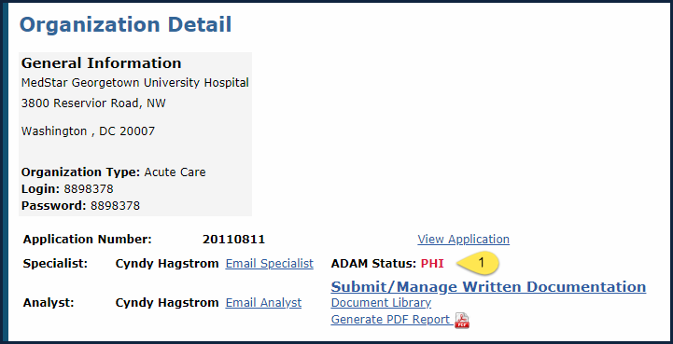
Organizational Detail with PHI Identified
Notes:
When an application is placed in PHI status, the Organization Administrator is notified of the specific Organization Overview or SOE/Examples where the PHI was identified. They receive information about when the PHI must be resolved. The organization is responsible to review all other areas of the document for PHI and remove it. If PHI is found again, the application review will cease.

Slide 64
PHI/Additional Documentation Request Locations Unlocked for Resolution
Notes:
1-2 The unlocked padlocks indicated that the submitted OO or SOE/Example needs to be edited for one of two reasons:
a. PHI was identified
b. Additional documentation is needed.

Slide 65
PHI Not Addressed by Due Date
If the Organization does not resolve PHI before the date set by the Magnet Senior Program Analyst:
All content submitted for the example(s) identified as having PHI will be deleted from the system.
The History links for the example(s) identified as having PHI will lead to a blank screen.

Slide 66
Navigation to History Link Content
In the left navigation select the Component, then the SOE, then the Example, then the version of the Example to reach the Submitted Example.
The history content for each status will open in the browser on a new tab.

Slide 67
Simple Upload
History of Statuses for an SOE/Example

Slide 68
Questions?

